Slide 1

Long-term effects on households and adult children of Malawi’s National Cash Transfer Program
PhD students
Paul Sirma, Marwa Ibrahim, Audrey Pereira, Dharini Bhatia, Juba Kafumba
Faculty
Sudhanshu Handa, Maxton Tsoka, Joseph Chunga, Clare Barrington, Allison Aiello, Carolyn Halpern, Gustavo Angeles
Project Manager
Susana Fajardo
November 2024

Slide 2

The Transfer Project
https://transfer.cpc.unc.edu
Research initiative to measure
broad impacts of cash transfers
in SSA

Slide 3
The ‘quiet revolution’ in sub Saharan Africa

Slide 4
The Malawi Social Cash Transfer Pogramme (SCTP) is the country’s largest social protection program
In 2024 reached 1.5m people living in 310,000 rural households, ~10% of the population
Eligibility criteria based on ultra-poverty and high dependency ratio
Transfer value averages Mk13,000 per household per month (US$8), paid bimonthly in cash
  Actual value depends on household size up to a cap of four members
  Small top-up for school-aged children

Slide 5
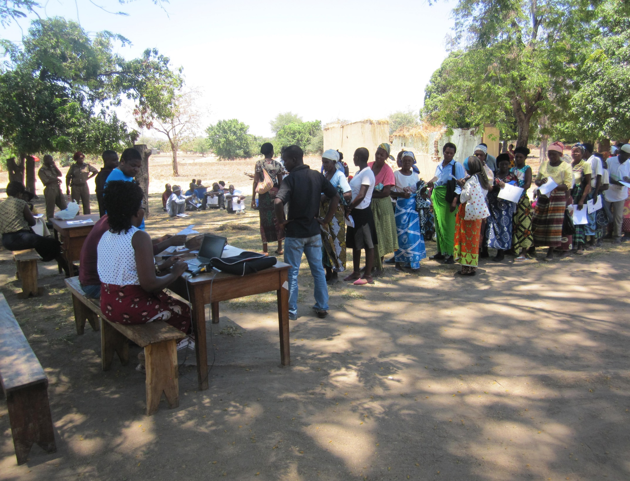

Slide 6
Impact evaluation of SCTP 2013-2015
Cluster randomized trial in two districts, timed to coincide with gradual expansion of the program
2013 (baseline); 2014 and 2015 (post-treatment waves)
  N=3,500 households, half randomized to delayed entry status
  High fidelity of design, 4 percent attrition (non-selective)
Over a dozen papers documenting the breadth of impacts on households as well as community-level spillovers
  Daidone et al AJAE 2019; Handa et al WBRO 2018; Kilburn et al JPAM 2018; Handa et al. DPR 2022; Molotsky & Handa JAE 2020; Lambon-Quayefio et al WD 2024
  Intervention had a seemingly transformative effect on households

Slide 7
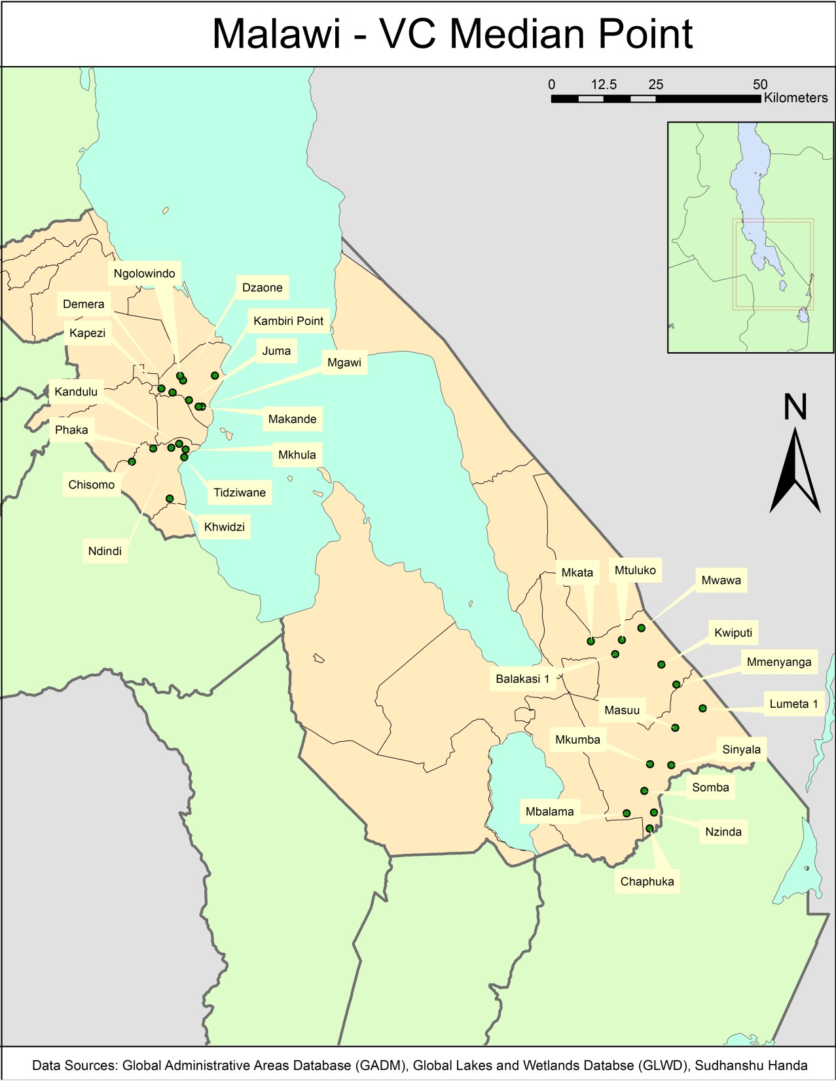
Map of Study Areas
SALIMA
Maganga TA
T= 354 HH
C= 515 HH
Ndindi TA
T= 446 HH
C=460 HH
MANGOCHI
Jalasi TA
T= 378 HH
C=375 HH
M’bwana Nyambi TA
T= 500 HH
C= 503 HH
Notes:
By district:
Salima: 800 T/ 975 C
Mangochi: 878 T/ 878 C

Slide 8
RCT from 2013-2015 showed large impacts across protective and productive domains
Handa et al DPR 2022

Slide 9
Initial RCT estimated a significant multiplier effect of the SCTP (Handa et al DPR 2022)
Estimated total spending was 2.9 times the value of the transfer
  Increased revenue from crop sales as households reduced ganyu and increased investment in their own plots
  Reduction in debt, increase in cash savings
Does this multiplier imply ‘graduation’ from ultra-poverty?
  Baseline consumption was US$0.32/person/day, increased to US$0.82
  Still some of the poorest households in the world, large gains off a very low base
  Productive capacity strengthened, but households are labor-constrained

Slide 10
High dependency ratio leads to fewer able-bodied
members in eligible households

Slide 11
SCTP households have more specific vulnerabilities than typical ultra-poor housheold

Slide 12
Follow-up of original study sample funded by NIH (R01AG061437) (2019-2024)
Aim 1: Did the extra three years of cash confer a permanent advantage to the early T group?
Aim 2: Are there effects on the immune system? (led by Co-I Allison Aiello) (we were matched by Barbara Entwisle)
Aim 3: What impacts on the transition to adulthood among young adult children?
The follow-up surveys
  2021 – reinterviewed households
  2022 – reinterviewed young adults who were age 13-19 at baseline

Slide 13
Follow-up in 2021 - attrition 9 percent by, not selective (balance preserved across T and C)
Sample sizes and attrition rates by wave and study arm
 | Control | Treated | Total | Attrition from baseline
2013 (baseline) | 52.5% | 47.4% | 3,531
2015 | 52.6% | 47.4% | 3,396 | 4%
2021 | 52.3% | 47.7% | 3,207 | 9%

Slide 14
Baseline balance maintained in 2021 indicating no differential attrition
Baseline means for households remaining in sample in 2021 (panel)
 | Control | Treated | P-value
Total annual consumption pc (Mk) | 41,698 | 44,696 | 0.377
Annual food consumption pc (Mk) | 32,085 | 34,533 | 0.392
Never worry about food (last 4 weeks) | 0.159 | 0.146 | 0.732
Number of meals per day | 1.925 | 1.888 | 0.565
Raised goats, sheep, or chicken | 0.252 | 0.269 | 0.550
Total outstanding loan (last 12 months) | 620.519 | 563.850 | 0.564
Total outstanding credit debt | 152.678 | 165.310 | 0.721
Total value of crop harvest (MWK) | 18,454 | 20,062 | 0.626
Operating a NFE | 0.234 | 0.262 | 0.544
Quality of life index | 18.199 | 17.584 | 0.489
Number of observations | 1677 | 1530
Notes:
In Q1 2023 1US4 = MK360, so ~32 U.S. cents per person per day consumption

Slide 15
Aim 1: Impact on households of an extra three years of transfer receipt
Did the three extra years of cash confer any long-term advantage?
  Strong productive effects + multiplier suggests this could be likely
  Extremely low base + labor-constraints may place ceiling on further growth
  Overall context is harsh: rainfed agriculture, few linkages, no wage labor
If convergence, what does it look like (catch-up or ceiling)?
If permanent advantage, how and who?

Slide 16
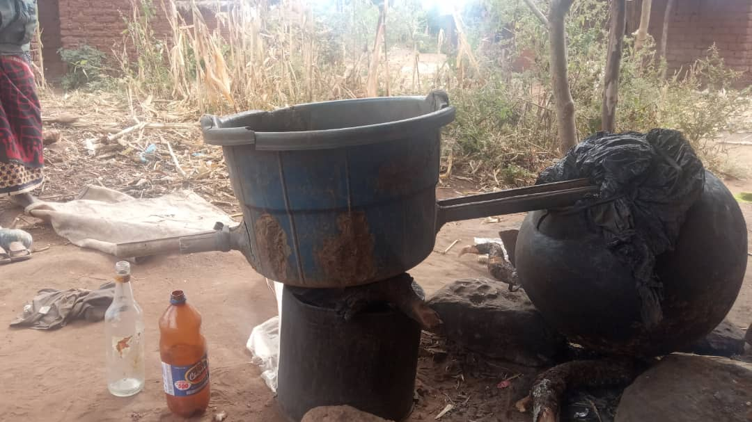
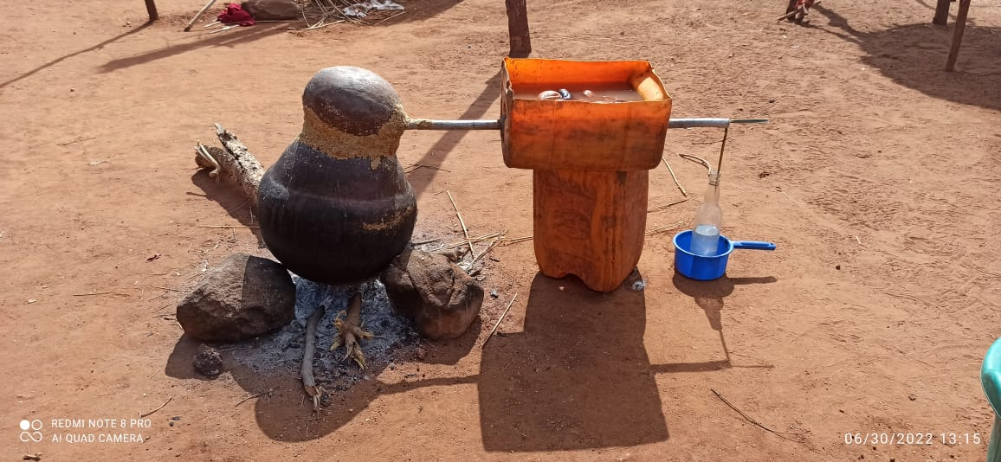
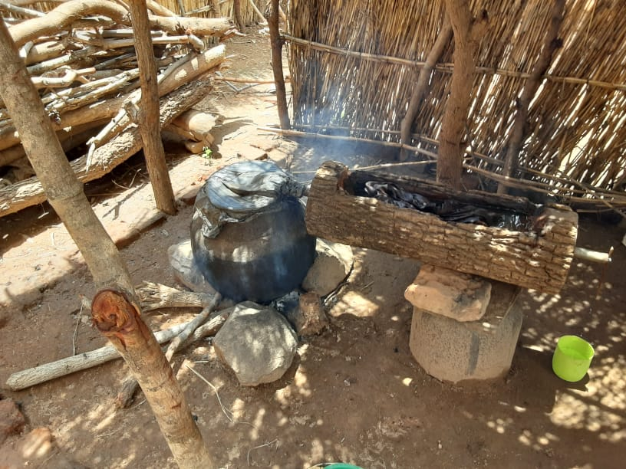
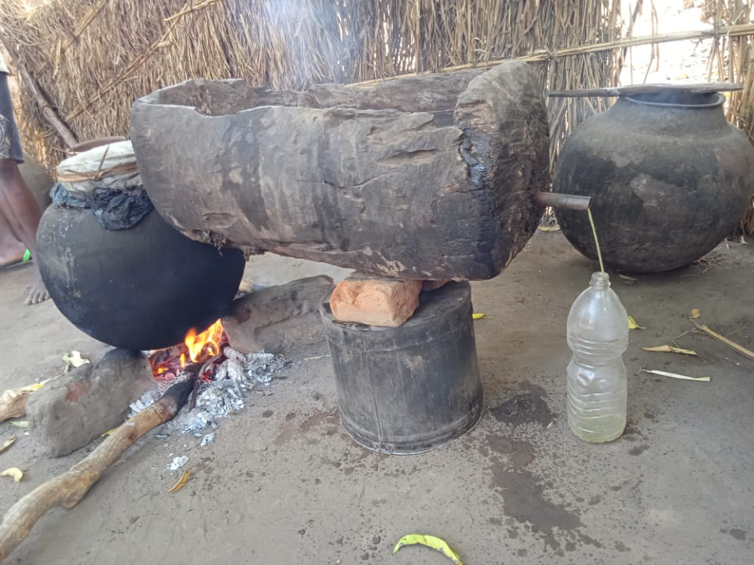
Very popular non-farm enterprise

Slide 17
Statistical approach replicates Handa et al DPR 2022 in order to compare impacts in 2015 vs 2021
For each indicator
  Create z-score by subtracting the C mean and dividing by C SD at each wave
  C variables have a mean 0 and standard deviation of 1 at each wave
  All variables coded so that higher value correspond to better outcomes
We create eight domain indexes
  Equally weight averages of all z-score indicators in that domain
  Then calculate the z-score for each index
Difference-in-differences
  In two cases we don’t have baseline and use single-difference
  Parsimonious set of control variables included, all measured at baseline + strata
  Clustered SEs, Sidak-Bonferroni adjustment for multiple hypothesis testing

Slide 18
Domains and indicators | 2013 | 2015 | 2021
Consumption | x | x | x
Food security
Does not (or rarely) worry about food | x | x | x
Number of meals per day in the household | x | x | x
Assets
Livestock index | x | x | x
Productive assets | x | x | x
Domestic assets |  | x | x
Finance & debt
Any savings |  | x | x
Amount saved |  | x | x
Reduction in the total outstanding debt | x | x | x
Income & revenue
Value of harvest | x | x | x
Operating a non-farm enterprise (NFE) | x | x | x
Revenues from NFEs | x | x | x

Slide 19
Domains and indicators | 2013 | 2015 | 2021
Subjective well-being (WHO)
In most ways my life is close to ideal | x | x | x
The conditions in my life are excellent | x | x | x
Satisfied with my life | x | x | x
Have gotten the important things I want in life | x | x | x
If I could live my life over, I would change almost nothing | x | x | x
I feel positive about my future | x | x | x
I generally feel happy | x | x | x
I am satisfied with my health | x | x | x
Schooling (aged 5-17)
Attends school | x | x | x
Material needs (ages 5-17)
Has a pair of shoes | x | x | x
Has at least two sets of clothes | x | x | x
Has a blanket (either shared or owned) | x | x | x

Slide 20
For every domain index, the original program impact in 2015 disappears by 2021
* Single difference

Slide 21
Original T continues to show improvement, original C catches up
C T

Slide 22
-Households are labor-constrained, recipients are elderly (mean age 55 years)
-Time discounting (green line) seems higher among older recipients – more myopic
-We do see larger productive impacts among younger recipients in 2015, persists
for livestock only in 2021

Slide 23
Aim 3: Transition to adulthood (next generation effects)
At baseline we fielded a ‘youth module’ for up to three residents aged 13-19 years; followed up in 2014 and 2015
Went back to reinterview these youth in 2022, now aged 22-28
Target list of 3,007 young people, managed to interview 2124 (71%)
  More likely to interview women; less likely to interview those who moved out of the village
  No differential attrition

Slide 24
Comparing baseline characteristics of the panel: Y = B₀ + B₁*T + u_{i}
Variables (Y) | B₁ (Difference between T and C) | p-value | B₀ (Mean for C group)
Head literate | -0.04 | 0.4 | 0.26
Head’s age | 0.78 | 0.72 | 53.66
Head is widowed | 0.02 | 0.60 | 0.38
Head never married | 0.00 | 0.89 | 0.04
Household size | -0.11 | 0.60 | 5.82
Household members 0 -17 years of age | -0.03 | 0.83 | 3.78
Age of respondent | -0.01 | 0.91 | 24.25
Started a new household by 2021 ** | 0.08 | 0.09 | 1.512
Highest grade attained ** | 0.15 | 0.62 | 5.44
Female respondent | -0.05 | 0.20 | 0.57

Slide 25
Audrey Pereira: Impacts on IPV and Relationship Quality (current or most recent romantic partner)
Relationship Flourishing Scale (Fowers et al 2016)
  12-items measuring goal sharing, giving, personal growth and meaning
Dyadic Trust Scale (Larzalere & Huston 1980)
  8-item scale, split into benevolence and honesty
Intimate Partner Violence
  Sexual, physical and emotional

Slide 26
SCTP impacts on relationship quality
results
Notes:
Here are our main results.
Overall we see positive impacts of the SCTP on young women’s perception of partner’s benevolence and relationship flourishing score
We didn’t see any effects on honesty
And we didn’t see any impacts of the cash transfer on young men’s relationship quality or on young women’s reported IPV

Slide 27
Perceptions of partner’s
benevolence
Mediation results
Relationship flourishing
HH worry about food
Social support
CES-D (2015)
CES-D (2022)
Notes:
So for the two variables with impacts for young women, we tested mediation individually for each of the home environment indicators
This is the proportion of the total effect that was mediated by each indicator
There were no short-term or long-term impacts on years of schooling
There’ were short term impacts on HH worry about food, social support and CES-D in the SR, and for CES-D in the LR
And we find that improved mental health is overall a very important mediator

Slide 28
Dharini Bhatia: Impact on non-cognitive characteristics and gender differences
Collected the short-item Big Five Inventory, Grit, Agency
Literature suggests that some elements of ‘personality’ are malleable, especially during adolescence and young adulthood
  Environmental factors (family circumstances) important determinant
  Often referred to as ‘non-cognitive skills’ to emphasize they are not fixed

Slide 29
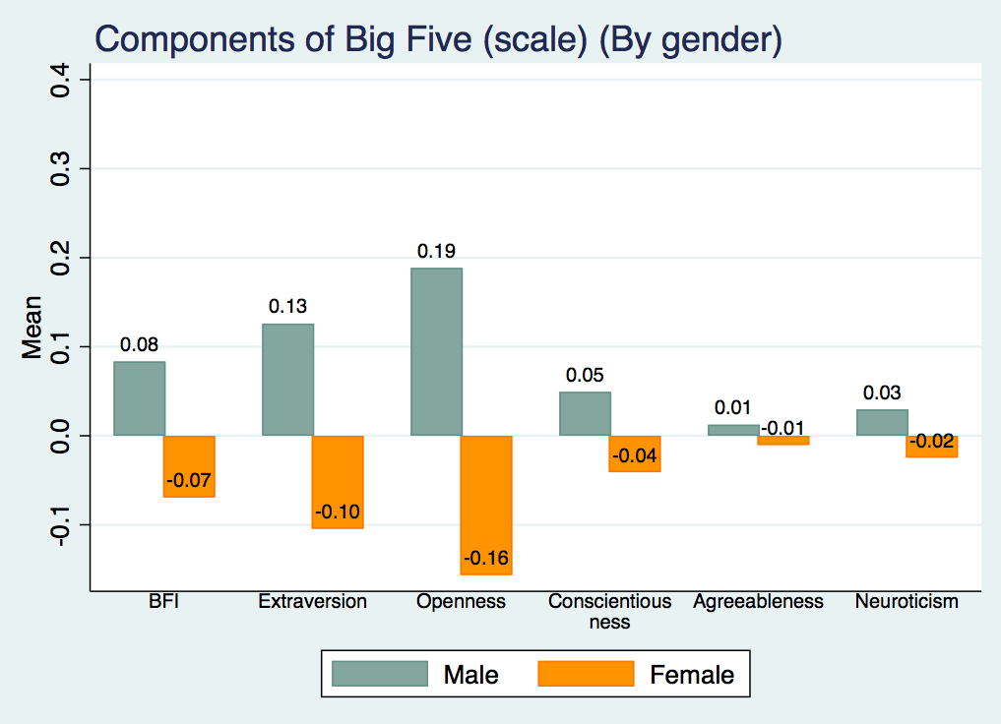
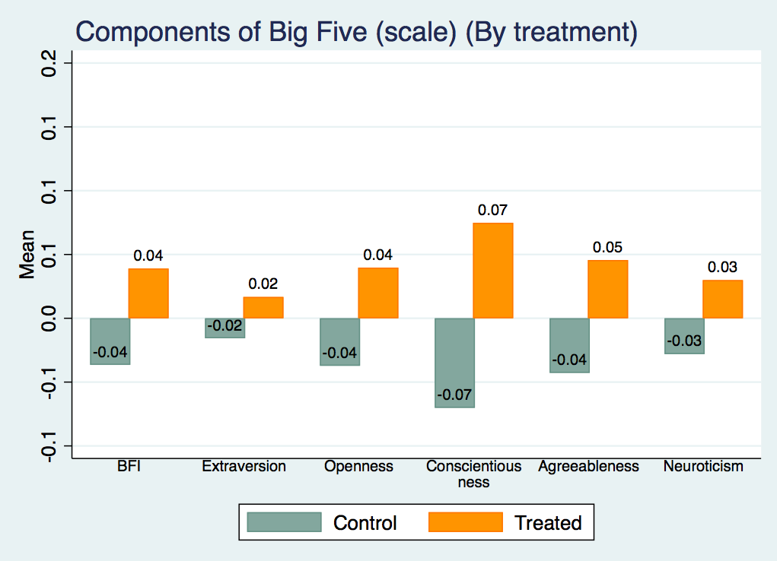
Bivariate analysis shows strong differences between T and C and men and women

Slide 30
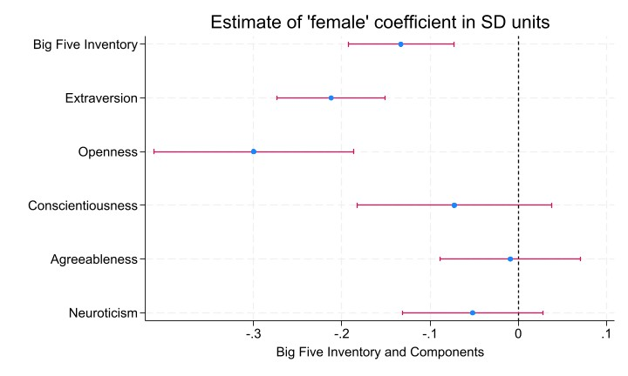
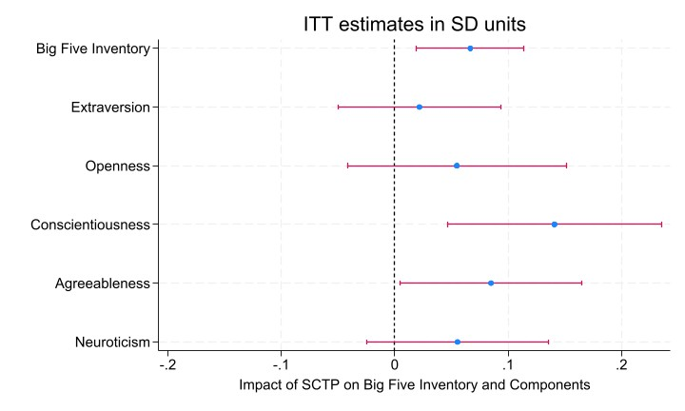
Single difference regression estimates measuring differences by sex and treatment effect

Slide 31
Marwa Ibrahim: Impact of the SCTP on mobility of young people
Context is very harsh, static, with limited economic opportunities and socially isolated
Moving to a more dynamic location (town, city) is a key pathway for raising living standards
  Remittances also benefit sending household
Evidence from Mexican that CT increases long-distance migration

Slide 32
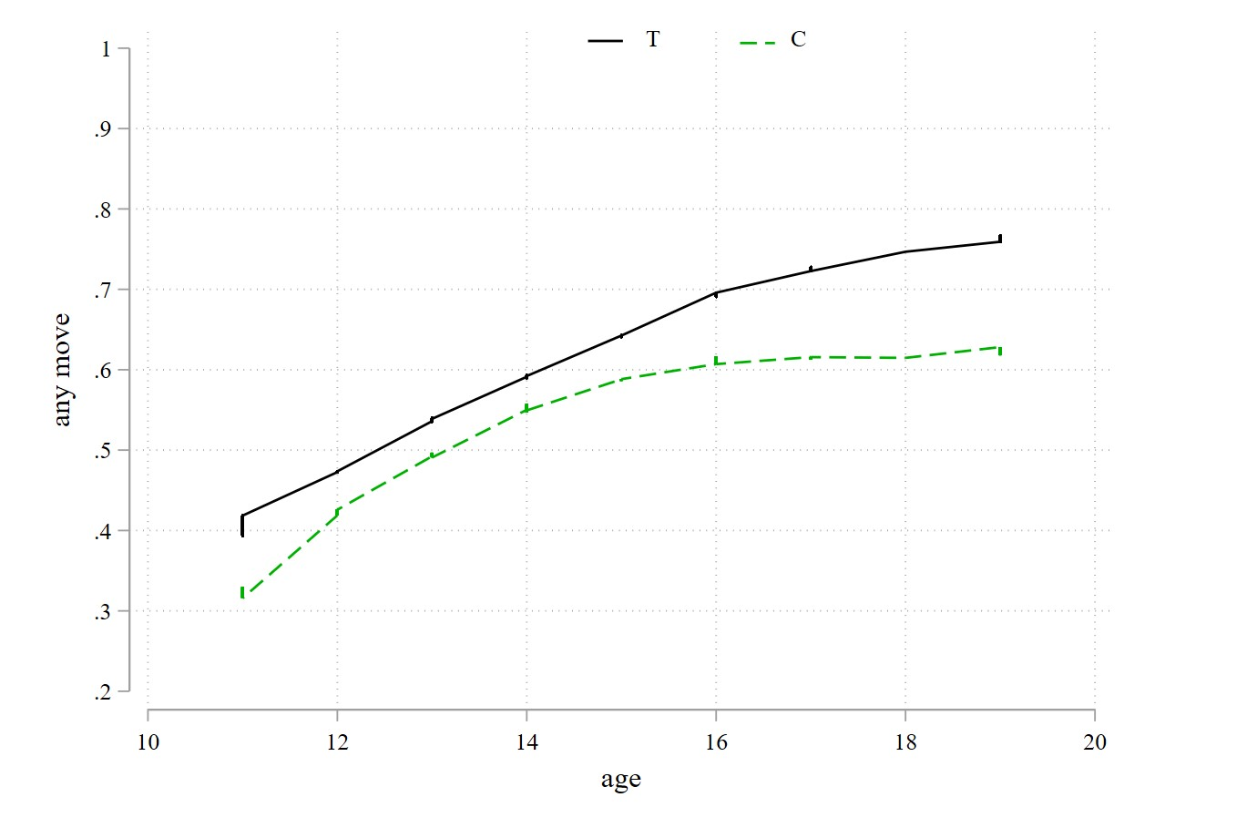
SCTP increases mobility by 5.5pp; treatment effect larger for older age group

Slide 33
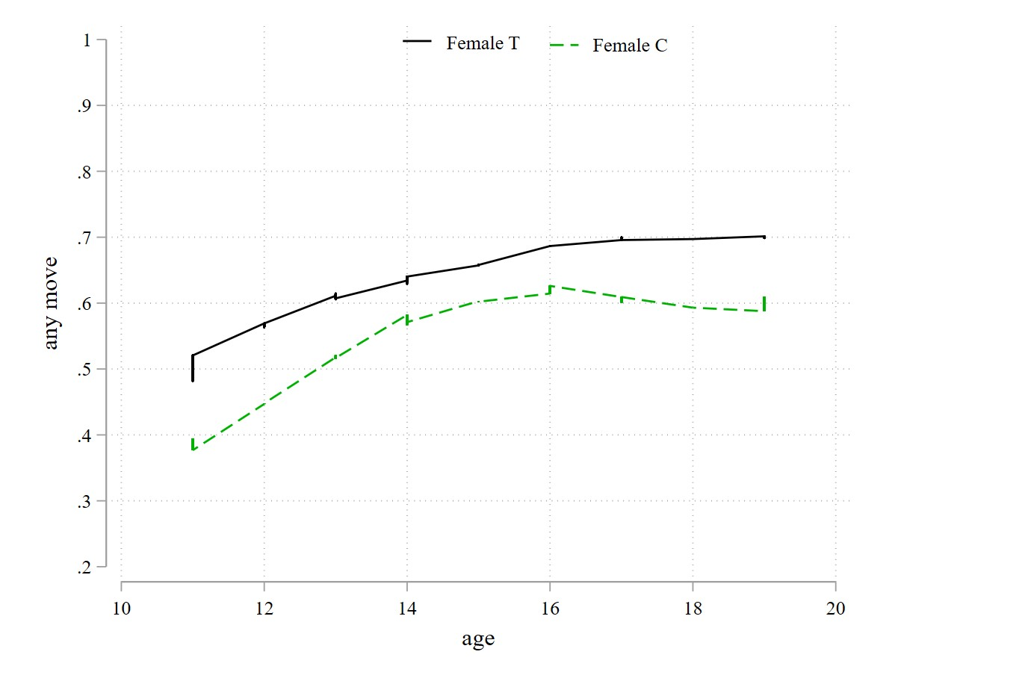
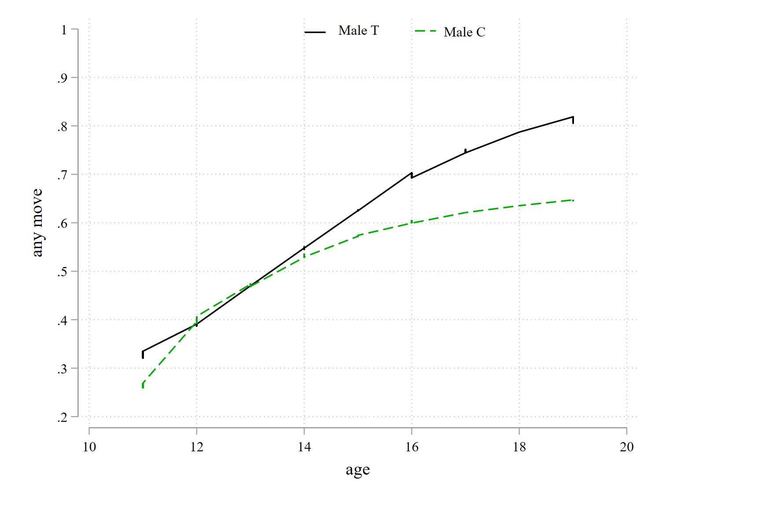
Treatment effect larger for women, leads to more long-distance (migration) moves; For men, SCTP extends mobility for longer, but moves are primary local

Slide 34
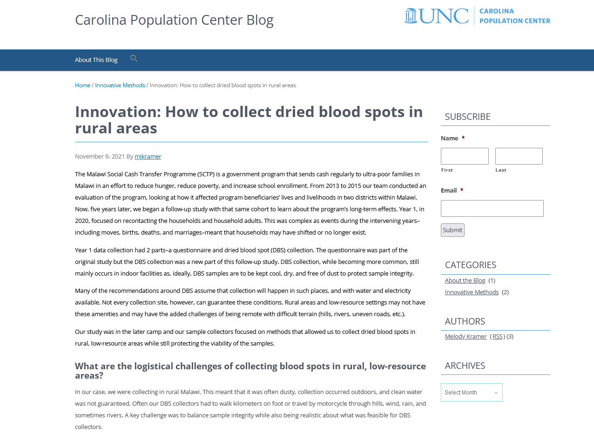
Aim 2: Effect of income support on the immune system
Collected DBS during COVID-19!!!!
https://cpcblog.cpc.unc.edu/2021/11/09/innovation-how-to-collect-dried-blood-spots-in-rural-areas/

Slide 35
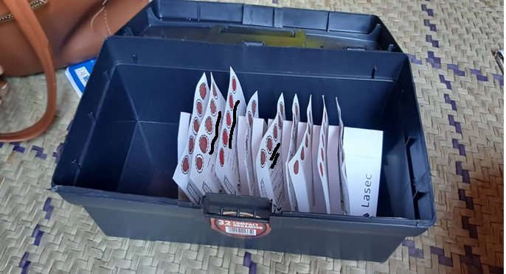
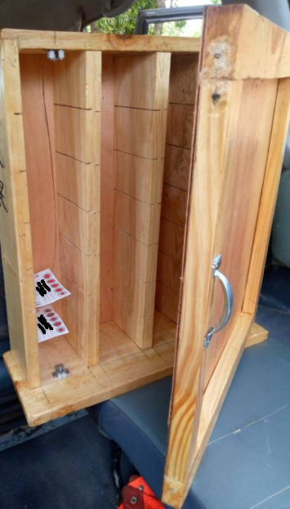
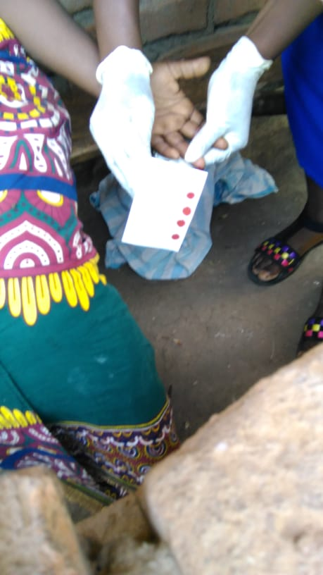

Slide 36
Universal prevalence of HSV1 and CMV in both older adults and young adult children
Currently looking at levels of antibodies—these increase with age, and are higher for women for CRP and CMV but higher for men for HSV1
‘Diseases of the poor’ are an even larger issue among poor populations in Africa, has not been documented before

Slide 37
Conclusions so far from this work
Aim 1: Almost finished with main paper, looking into heterogeneity now
  Will then look specifically into physical health and cognitive functioning of adults
Aim 2: Publish paper documenting universal presence of ‘diseases of the poor’ in this population
  Start looking at hypertension
Aim 3: Very promising evidence of inter-generational effects of this CT
  Much needed for policy discourse, these programs are under constant threat

Slide 38
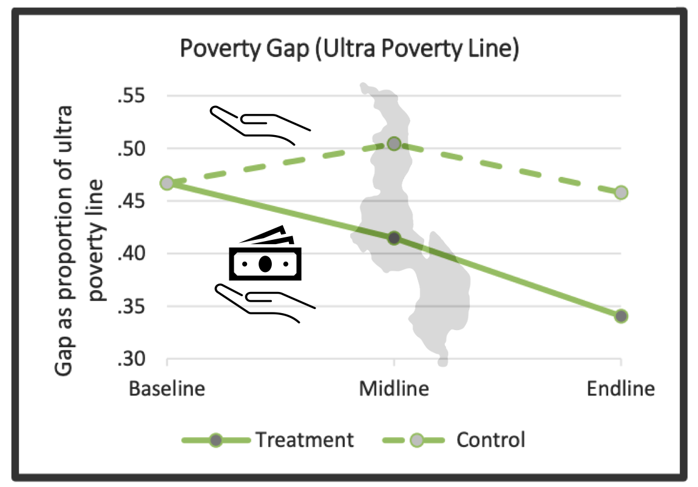


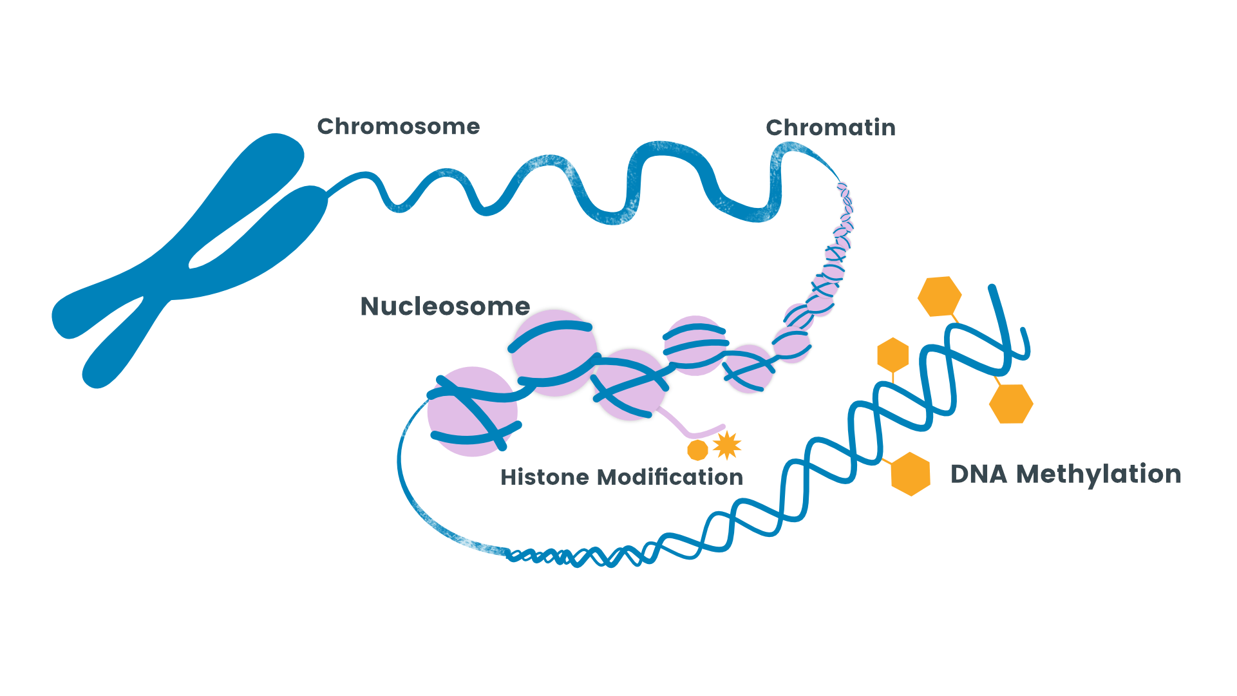





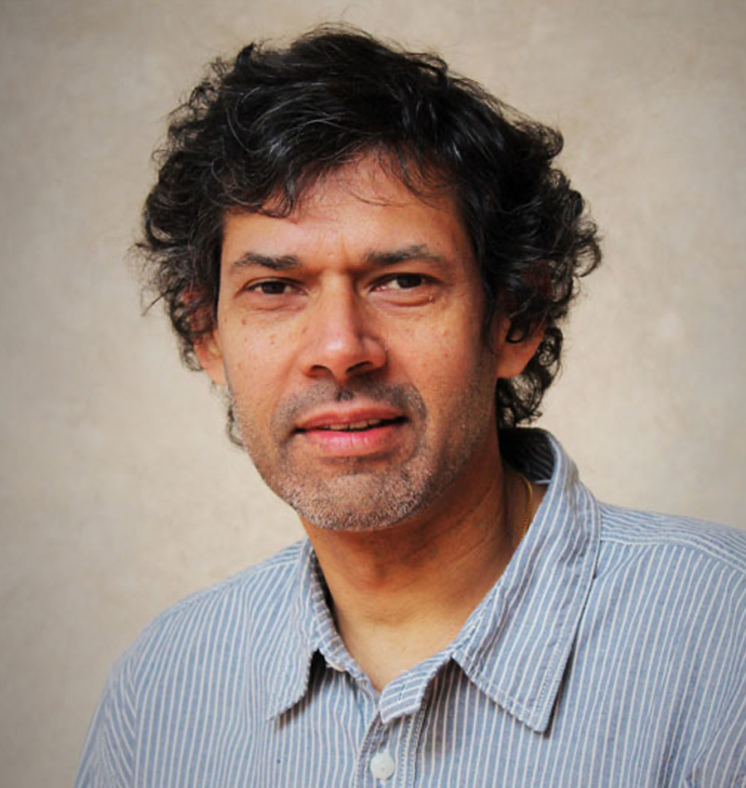

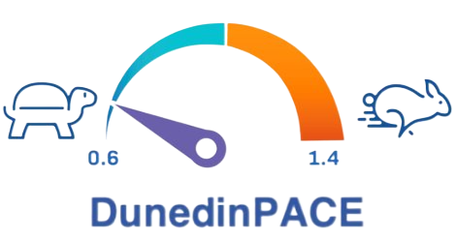
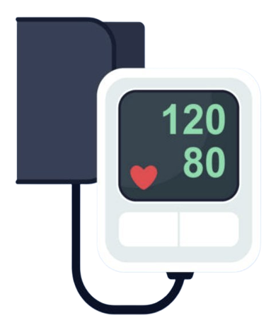
Testing effects of cash transfers on biological aging and risk for Alzheimer's
Disease, R01AG087158
Socioeconomic Intervention
Biological Markers
of Longevity
Other Measures of Health
Neurocognitive Testing
Height & Weight
Blood Pressure
MPIs
Aiello
Handa
Belsky

